Slide 1
Apache Spark
Presenter: Rehmana Younis
Date: September 24, 2022

Slide 2
Agenda
Introduction to Apache Spark
Spark Framework
Spark Popularity
Why Scala
RDD’s
SparkML

Slide 3
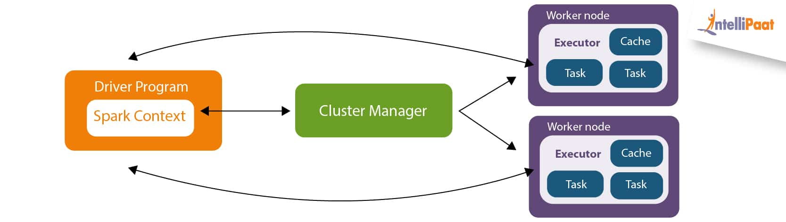
What is Apache Spark
An Open Source data processing engine for large scale data processing.
Spark/YARN
Its Scalable

Slide 4
Spark Framework
The Spark framework includes:
Spark Core as the foundation for the platform
Spark SQL for interactive queries
Spark Streaming for real-time analytics
Spark MLlib for machine learning
Spark GraphX for graph processing

Slide 5
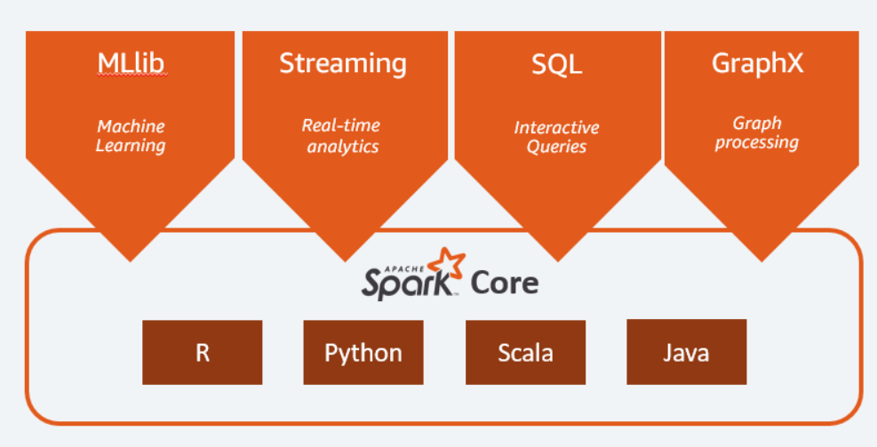
Spark Framework

Slide 6
Spark Core
Spark Core is the foundation of the platform.
Memory management
Fault recovery
Scheduling
Distributing & monitoring jobs
Interacting with storage systems
Spark Core is exposed through an application programming interface (APIs) built for Java, Scala, Python and R. These APIs hide the complexity of distributed processing behind simple, high-level operators.

Slide 7
Why Spark So Popular
Spark replaces Hadoop MapReduce by being 100* times faster, due to its in memory implementation.
DAG Engine (Directed Acyclic Graph) optimizes work flows
Code in Python, Java, Scala
SQL compatibility with Spark Datasets and DataFrames
Lower level API Resilient Distributed Dataset

Slide 8
Why Scala
Spark is itself written in Scala
Functional Programming Model best fit for distributed processing
Scala compiles to byte code and hence gives fast performance
Less Code
Python is comparative slow

Slide 9
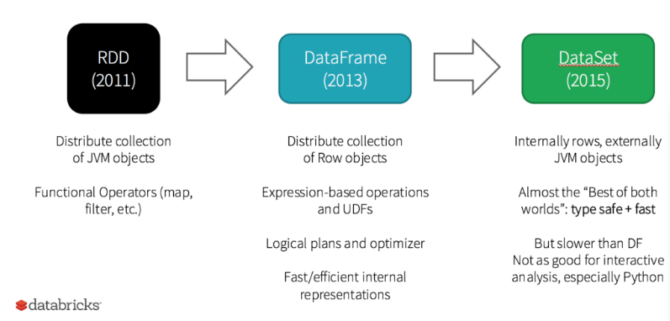
History of Spark API’s

Slide 10
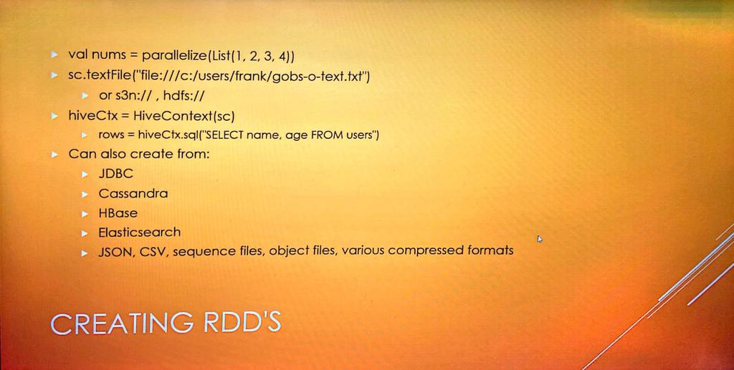
RDD’s Resilient Distributed Datasets

Slide 11
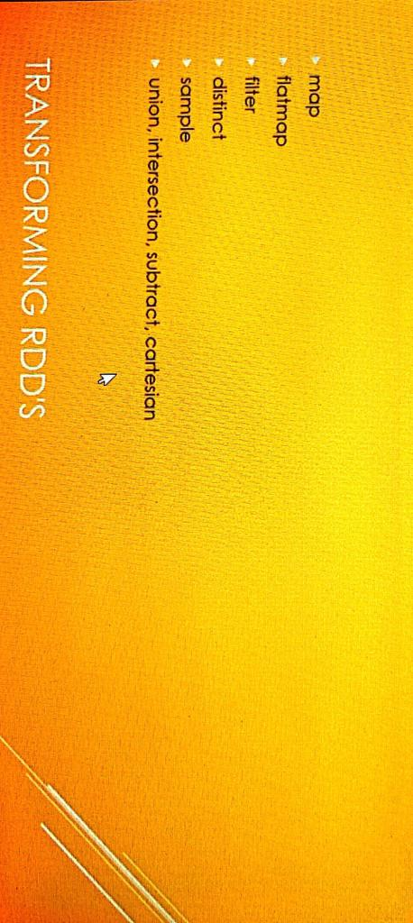
RDD’s Resilient Distributed Datasets

Slide 12
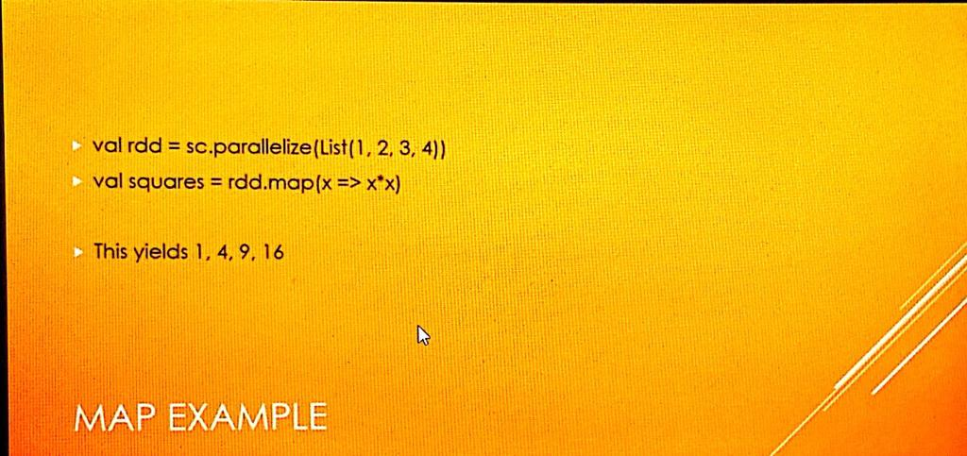
RDD’s Resilient Distributed Datasets

Slide 13
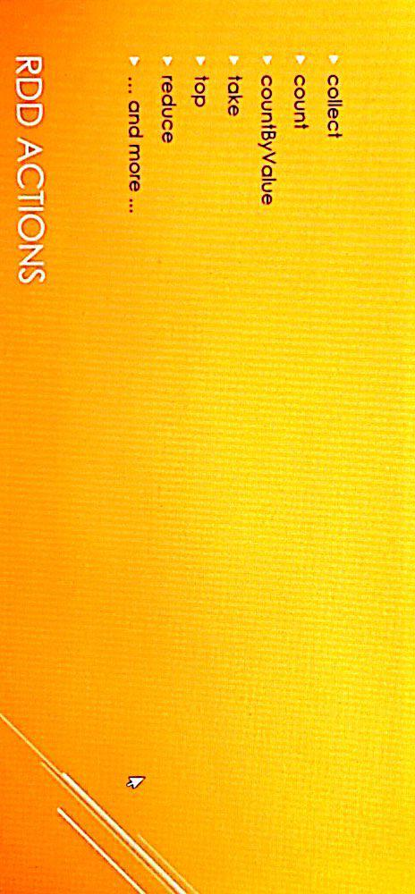
RDD’s Resilient Distributed Datasets
Nothing happens in driver program until an action is called.
Reason: DAG is created for optimization

